Slide 1
GRAND GATEWAY - GRADE SEPARATION STUDY Public Information Meeting #2
May 24, 2022
Notes:
Welcome to the second Public Information meeting for the Grand Gateway - Grade Separation Study!
We look forward to sharing with you the project details, alternatives being considered, and the alternatives evaluation process. Engaging and soliciting feedback from the community will help ensure that the analysis and subsequent recommendations correspond to local conditions and solutions. Thank you for sharing with us your feedback on the project.
Once the presentation is complete, we invite you to the gymnasium to review exhibits and discuss the project with the project team. This presentation will continue to replay for the remainder of the open house if you wish to see it again.
Again, thank you for your time, we look forward to sharing information on the Grand Gateway - Grade Separation Study.

Slide 2
AGENDA
Project Overview
Schedule of Project
Public Information Meeting #1 Overview
Community Advisory Group Meetings Overview
Alternatives Analysis
Criteria for Evaluation
Next Steps
Notes:
The agenda for the presentation is:
A project overview
Schedule of the project
An overview of Public information meeting #1
And overview of the Community Advisory Group Meetings
Alternatives Analysis
Criteria for Evaluation, and
Next Steps

Slide 3
PROJECT OVERVIEW
Notes:
We are going to provide a brief project overview before presenting new information.

Slide 4
THE PROJECT TEAM
Notes:
The stakeholders working on this project are compromised of representatives from the design team as well as local agencies and municipalities, chambers of commerce, local institutions, park and environmental organizations, and transit agencies.

Slide 5
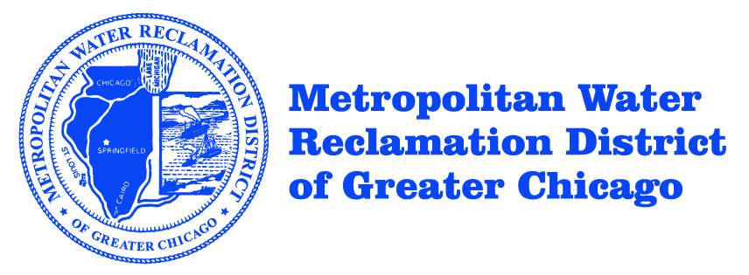
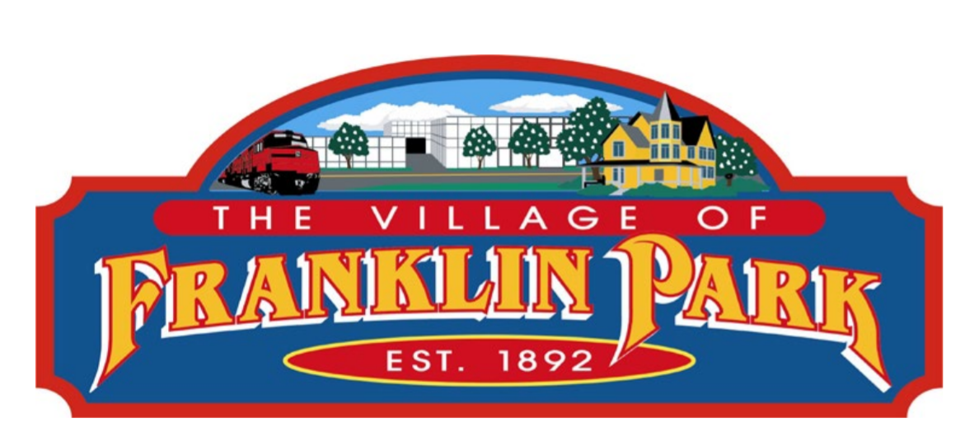
INTRODUCTIONS Project Team & Community Advisory Group Members
Toni Preckwinkle, Cook
County President
Peter Silvestri, Cook County Board Commissioner, 9th District
Angelo “Skip” Saviano, Village President
Omer Osman, Secretary of Transportation
Notes:
The team that is working on this project includes staff from:
The Village of Elmwood Park
The Illinois Department of Transportation
Cook County
Metro Strategies Group
Knight Engineers and Architects
ESI Consultants
GSG Consultants
ALTUS Works
We have also listed our Community Advisory Group (or CAG) members including the Chicago Metropolitan Agency for Planning, the Metropolitan Water Reclamation District, Christopher Burke Engineering, Leyden (Lie-Den) Township, Franklin Park, River Grove, the Federal Transit Administration, the Illinois Commerce Commission, the North Central Council of Mayors, Pace, the Regional Transit Authority, the Grand Avenue Chamber of Commerce, the Federal Highway Administration, the Canadian Pacific Railway, and Metra.

Slide 6
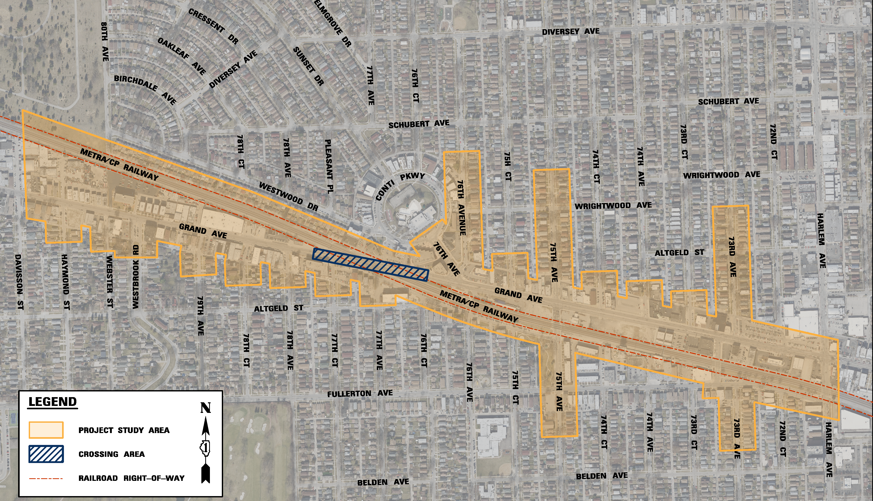
PROJECT STUDY AREA
PROJECT STUDY AREA
Notes:
The project study area is shown in orange.
Grand Avenue at the METRA/Canadian Pacific Railway crossing is located 0.6 miles west of Illinois Route 43 (Harlem Avenue) in the Village of Elmwood Park. ​
The approximate study limits extend from 78th Court to 75th Court along Grand Avenue; a length of approximately a half of a mile. ​
Overall limits may be expanded as required for:​
Traffic management and construction staging​
Drainage and associated routing and connections​
Horizontal and vertical railroad alignments; both permanent and temporary ​

Slide 7
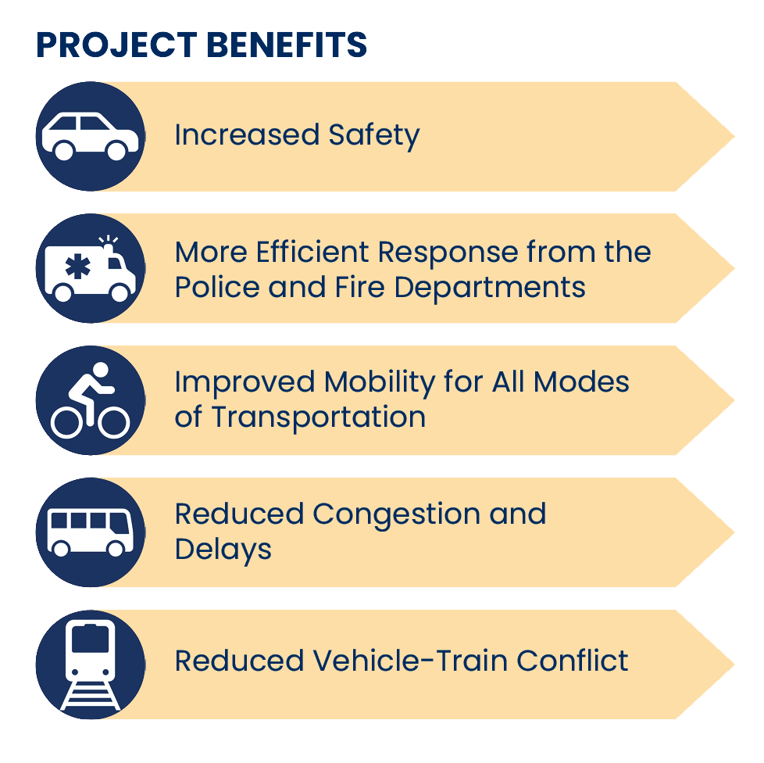
PROJECT OVERVIEW Project Objective/ Potential Benefits
Notes:
The project objective is to develop a preferred alternative that accommodates and improves roadway traffic and rail operations, safety, travel efficiency, reliability, and regional mobility.
A grade separation would improve safety and regional mobility for vehicles, pedestrians, and bicyclists through the Grand Avenue crossing and associated corridor.
In addition to improving public safety, this project has several local and regional benefits. The grade separation would reduce vehicular traffic congestion and delays and facilitate a more efficient emergency response from both the fire and police departments.
A grade separation would eliminate conflicts and delay between vehicles, bicycles, pedestrians and trains. Reliability would also be increased.
Any impacts to environmental resources, properties, and land use would also be quantified.
In the event that an alternative would cause an existing property’s access to be impacted or eliminated, alternate access options would be identified, evaluated and quantified.

Slide 8
PHASE I STUDY TIMELINE
Notes:
We are more than halfway through this study. Following the public input received from this meeting, we plan to engage the public again through the fourth and final Community Advisory Group meeting.
Once a preferred alternative has been determined, we will proceed to a Public Hearing so that the team can make any final changes before submitting for design approval, anticipated to occur in 2023. ​

Slide 9
PROJECT DEVELOPMENT PROCESS
Notes:
Transportation projects follow a distinct process for studying, designing, contract preparation, and construction. Public engagement and involvement occurs during all phases.

Slide 10
PUBLIC INFORMATION MEETING #1
Notes:
Upon completion of the second CAG meeting, the first Public Information Meeting was held in April of 2021.

Slide 11
PUBLIC INFORMATION MEETING #1
Held virtually: April 21, 2021
Participants: 100
Agenda:
Project Overview
PEL Study
Draft Problem Statement
Draft Purpose and Need
Breakout Sessions
Roadway Overpass Example
Roadway Underpass Example
Shared-Use Path
Grand Avenue passes below Street road
Sidewalk
Notes:
The meeting was held virtually due to COVID restrictions and 100 people participated via zoom.
Information about the study was presented to the public, including the draft problem statement and purpose and need for the project. Virtual breakout rooms were used to facilitate discussion and allow for questions and answers.

Slide 12
PURPOSE AND NEED STATEMENT
The purpose of the project is to alleviate congestion and improve safety and mobility to all transportation users at the Grand Avenue and Metra/Canadian Pacific Railway crossing. In addition to improving safety, project improvements are expected to increase mobility throughout the region.
Notes:
The purpose of the project is alleviate existing congestion and improve safety and mobility to all transportation users at the Grand Avenue and Metra/Canadian Pacific Railway crossing.
In order to perform an initial evaluation of each alternative, the Project Team utilizes a screening process. In summary, this process focuses on the following elements:
The safety and overall transportation benefits of the alternative.
An assessment of impacts to the environment, future land use, overall property displacements, and property impacts, including access and parking impacts.
Construction duration and associated disruption during construction – adverse travel times.
Impacts to community cohesion
Overall Construction Cost

Slide 13
SCREENING PROCESS + PROJECT PURPOSE
SCREENING PROCESS
Alternative must satisfy the project purpose and need:
Project Need:
The 10 degree crossing skew angle results in an unconventionally long crossing which requires vehicles an above average amount of time to traverse the crossing.
The unsafe existing crossing condition causes vehicles to be potentially trapped on the railroad crossing.
The Federal Railroad Administration 2020 Accident Prediction Report ranks this crossing as the sixth most likely to have a collision out of 7,920 crossings in the State of Illinois.
In 2005, the National Transportation Safety Board recommended that a grade separation be constructed at the Grand Avenue grade crossing.
The current and future demands of vehicular, railway, and pedestrian traffic dictate the need to address existing deficiencies.
Current peak traffic volumes on Grand Avenue and the surrounding roadway network result in a high level of congestion within this region.
Project Purpose:
Alleviate congestion and mobility to roadway (vehicular, pedestrian, bicyclists) transportation users at the Grand Avenue and Metra/Canadian Pacific Railway crossing while eliminating roadway and train conflicts.
Notes:
In order for an alternative to be advanced for additional consideration, it must satisfy the requirements of the Project Purpose and Need. To reiterate:
Project Need
The 10 degree crossing skew angle results in an unconventionally long crossing which requires vehicles an above average amount of time to traverse the crossing.
The unsafe existing crossing condition causes vehicles to be potentially trapped on the railroad crossing.
The Federal Railroad Administration 2020 Accident Prediction Report ranks this crossing as the sixth most likely to have a collision out of 7,920 crossings in the State of Illinois.
In 2005, the National Transportation Safety Board recommended that a grade separation be constructed at the Grand Avenue grade crossing.
The current and future demands of vehicular, railway, and pedestrian traffic dictate the need to address existing deficiencies.
Current peak traffic volumes on Grand Avenue and the surrounding roadway network result in a high level of congestion within this region.
Project Purpose
Alleviate congestion and mobility to roadway (vehicular, pedestrian, bicyclists) transportation users at the Grand Avenue and Metra/Canadian Pacific Railway crossing while eliminating roadway and train conflicts.

Slide 14
COMMUNITY ADVISORY GROUP (CAG) MEETINGS OVERVIEW
Notes:
Three of the four Community Advisory Group Meetings slated for this project have been completed.

Slide 15
Community Advisory Group Meetings
CAG #1 (Held virtually) July 23, 2020
Agenda:
CAG Goals & guidelines
Project Overview
Project Timeline
Project Purpose & Need
CAG #2 (Held virtually) February 18, 2021
Agenda:
Draft Problem Statement
Draft Purpose & Need
Criteria for Alternative Analysis
CAG #3 (Held virtually) December 7, 2021
Agenda:
Reviewed 6 Alternatives
Discussed Alternatives Comparison
Discussed Evaluation Criteria Weight of Importance
Notes:
The first CAG Meeting was held on July 23, 2020. This meeting focused on goals and guidelines, the project overview, timeline, and the purpose and need.
The second CAG meeting was held on February 18th, 2021. This meeting delved into drafting a problem statement, the purpose and need statement, and developing criteria for the alternative analysis. These elements were presented in draft form at the first Public Information Meeting.
The third CAG meeting took place on December 7th, 2021. This meeting involved the review of six alternatives, alternative comparisons, and the evaluation criteria weight of importance. All of the information discussed at the third CAG Meeting will be shared today during this Public Information Meeting.

Slide 16
PROJECT BACKGROUND DATA
Notes:
To understand the project better, background data will be presented.

Slide 17
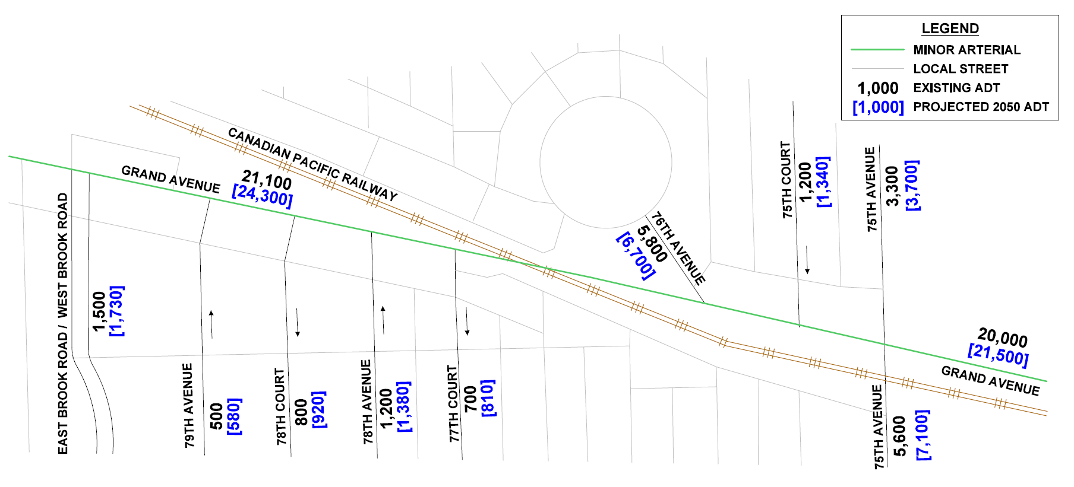
TRAFFIC VOLUMES
Notes:
Existing average daily traffic along Grand Avenue within the project area ranges from approximately 20,000 to 21,100 vehicles per day.
The weekday morning and evening peak hours for the study area were determined to occur from 6:30 AM to 7:30 AM and from 4:45 PM to 5:45 PM.
During the morning peak hour, the primary direction of travel is westbound, and during the evening peak hour the primary direction of travel is eastbound.
Average daily traffic for the design year 2050 is projected to range from approximately 21,500 to 24,300 vehicles per day - an increase of approximately 15%.

Slide 18
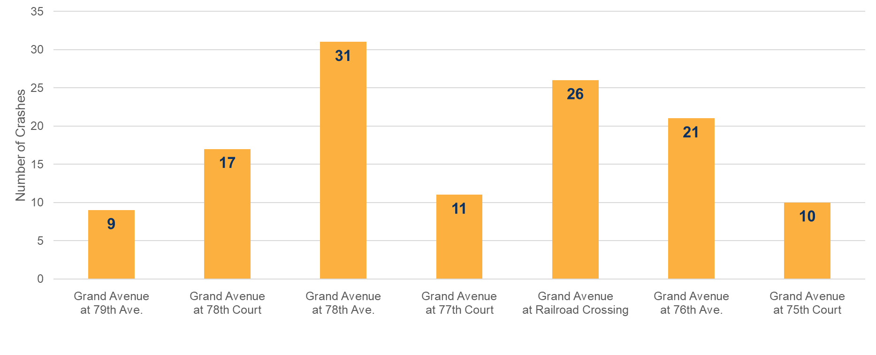
PROJECT OVERVIEW Crash Data Summary
CRASH STATISTICS BY INTERSECTION (2016 to 2020)
Notes:
Crash analysis along Grand Avenue was performed using crash data and collision diagrams provided by IDOT within the study limits during the five-year study period from 2016-2020.
Police reports from local law enforcement agencies were also referenced to verify the crash data.
This bar chart shows all crash data at the intersections along Grand Avenue from 79th Avenue to west of 75th Court. The highest number of crashes occurred at the intersection of Grand Avenue and 78th Avenue. The next highest number of crashes occurred at the railroad crossing.
In an 2007 study of crashes in the area, a total of 45 crashes were reported at the Grand Avenue Railroad crossing since 1956. Of these 45 crashes, 35 crashes (78%) involved a train hitting a vehicle, 4 crashes (9%) involved a vehicle hitting a train and the remaining 6 crashes (13%) involved a pedestrian. There have been a total of 8 fatalities and 27 injuries.

Slide 19
PROJECT OVERVIEW Crash Data Summary
CRASH STATISTICS BY TYPE (2016 to 2020)
Total Number of Crashes from 2016 to 2020 = 125
Other Includes:
Other Non-collision
Other Object
Pedestrian
Sideswipe Opposite Direction
Notes:
This pie chart illustrates the type of accidents that occurred between 2016 and 2020.
The majority of the accidents were due to rear end crashes, turning crashes, and sideswipe crashes.
The majority of crashes which occurred at the intersection of Grand Avenue and the railroad crossing were rear end crashes.

Slide 20
ALTERNATIVES ANALYSIS
Notes:
An Alternatives Evaluation Report was submitted to IDOT in October of 2021.
This report summarized the six alternatives that were developed, along with the their associated impacts.
All six of the alternatives propose a grade separation to satisfy the Purpose and Need.
Each Alternative is designed in accordance with the policies put forth by IDOT's Bureau of Design and Environment.
In addition to these six alternatives, a no-build alternative was considered, which maintains the current conditions in the study area.
The no-build alternative does not improve safety or alleviate congestion, and therefore does not satisfy the Purpose and Need.
The following descriptions summarize the six alternatives. Ultimately, one of these alternatives will be chosen as the final preferred alternative.

Slide 21
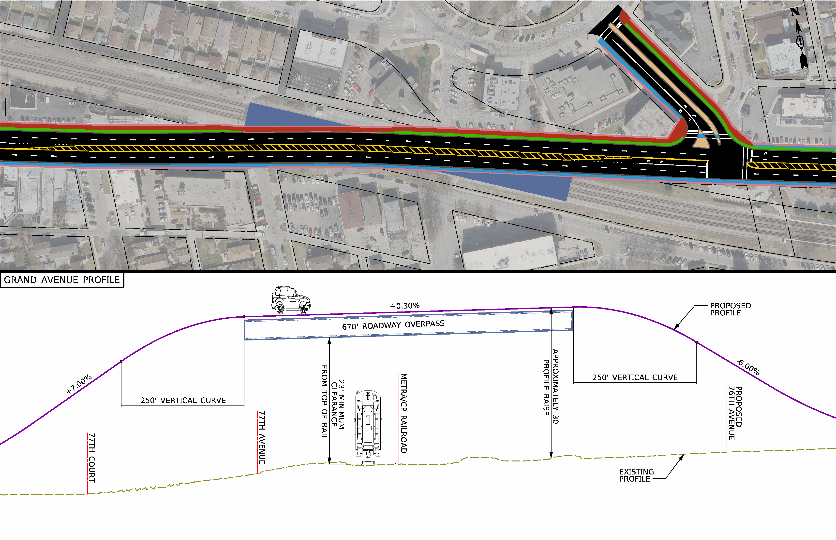
ALTERNATIVE #1 Grand Avenue Over Railroad
DESIGN:
Grand Avenue raised 30 feet over existing railroad
76th Avenue raised 17 feet
Concrete tunnel
2 12-foot lanes in each direction with a 12-foot median
7-foot sidewalk along south side of Grand Avenue and 10-foot shared-use path along north side of Grand Avenue
Notes:
Alternative 1 raises Grand Avenue approximately 30 feet over the existing railroad.
Consequently, 76th Avenue is raised approximately 17 feet to meet the proposed Grand Avenue profile.
A three-sided concrete tunnel would be constructed to accommodate all three railroad tracks.
The cross section for each of the six alternatives includes two 12-foot travel lanes in each direction, a 7-foot sidewalk on the south side of the roadway, and a 10-foot wide shared-use path on the north side of the roadway.
Each alternative also includes a 12-foot median, although Alternative 1 is the only Alternative that has a flush median. The remainder of the alternatives include a raised median.
Canadian Pacific Railway and Metra operations and services would be maintained during construction.

Slide 22
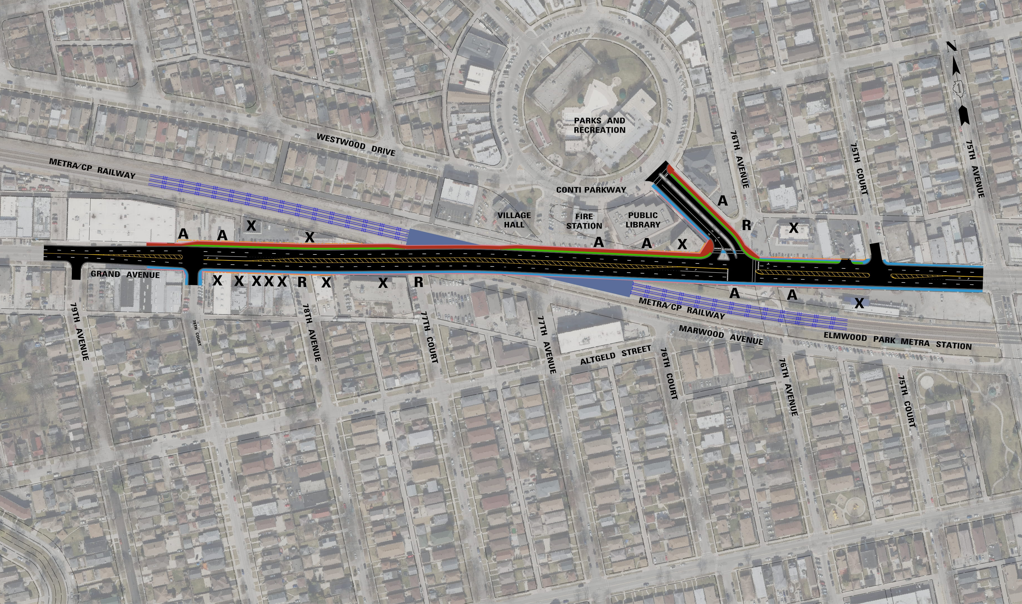
ALTERNATIVE #1 Grand Avenue Over Railroad
ISSUES:
Access to 78th Avenue removed
Access to 77th Court removed
Access to Fire Station and Library removed
Access to 76th Avenue spur removed
Access to Metra pick-up/drop-off removed
10 commercial displacements
2 residential displacements
47 parking spaces removed
Notes:
Due to the raising of the roadway profile in Alternative 1, access from Grand Avenue would be removed at 78th Avenue and 77th Court. The rear access to the Elmwood Park Fire Station and the Public Library would also be removed. The spur off of 76th Avenue would also be removed. Existing Grand Avenue access for the Pace bus stop and Metra station pick-up and drop-off area would be eliminated.
10 commercial properties and 2 residential properties along Grand Avenue would be displaced.
As shown here, and on the exhibits in the gymnasium, an "X" denotes a property displacements, an "A" denotes a property access impact, and an "R" denotes a roadway access impact.
Both on-street parking spaces and parking spaces behind the Elmwood Park Public Library and Fire Station would be impacted by the grade separation. A total of 47 spaces are estimated to be removed.

Slide 23
ALTERNATIVE #2 Grand Avenue Under Railroad
DESIGN:
Grand Avenue lowered 35 feet under existing railroad
76th Avenue lowered 5 feet
Two single-span bridges
Metra station reconstructed
Notes:
Alternative 2 lowers Grand Avenue approximately 35 feet under the existing railroad.
Consequently, 76th Avenue is lowered approximately 5 feet to meet the proposed Grand Avenue profile.
Two staggered single-span bridges, with a pier in the median, would carry the railroad over Grand Avenue.
Canadian Pacific Railway and Metra operations and services would be maintained during construction.
The Elmwood Park Metra Station would be reconstructed due to the implementation of temporary tracks during construction.

Slide 24
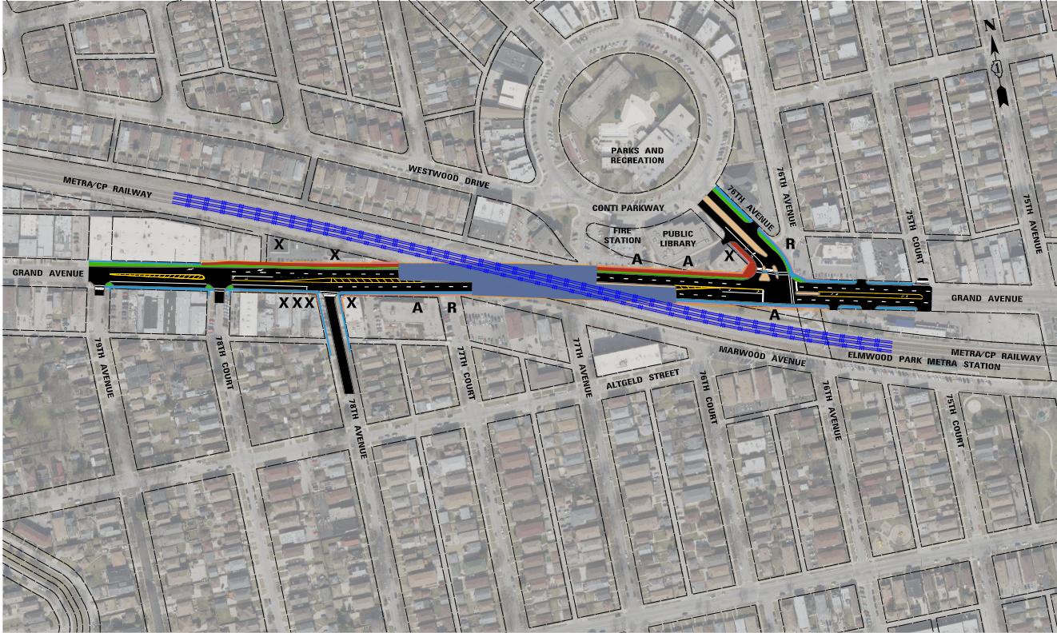
ALTERNATIVE #2 Grand Avenue Under Railroad
ISSUES:
Access to 77th Court removed
Access to Fire Station and Library removed
Access to 76th spur removed
Access to Metra pick-up/drop-off removed
5 commercial displacements
1 residential displacement
47 parking spaces removed
Notes:
Due to the lowering of the roadway profile in Alternative 2, Grand Avenue access would be eliminated at 77th Court. The rear access to the Elmwood Park Fire Station and Public Library would also be eliminated. The spur off of 76th Avenue would also be removed. Existing Grand Avenue access for the Pace bus stop and Metra station pick-up and drop-off area would be eliminated.
5 commercial properties and 1 residential property along Grand Avenue would be displaced.
Both on-street parking spaces and parking spaces behind the Elmwood Park Public Library and Fire Station would be impacted by the grade separation. A total of 47 spaces are estimated to be removed.

Slide 25
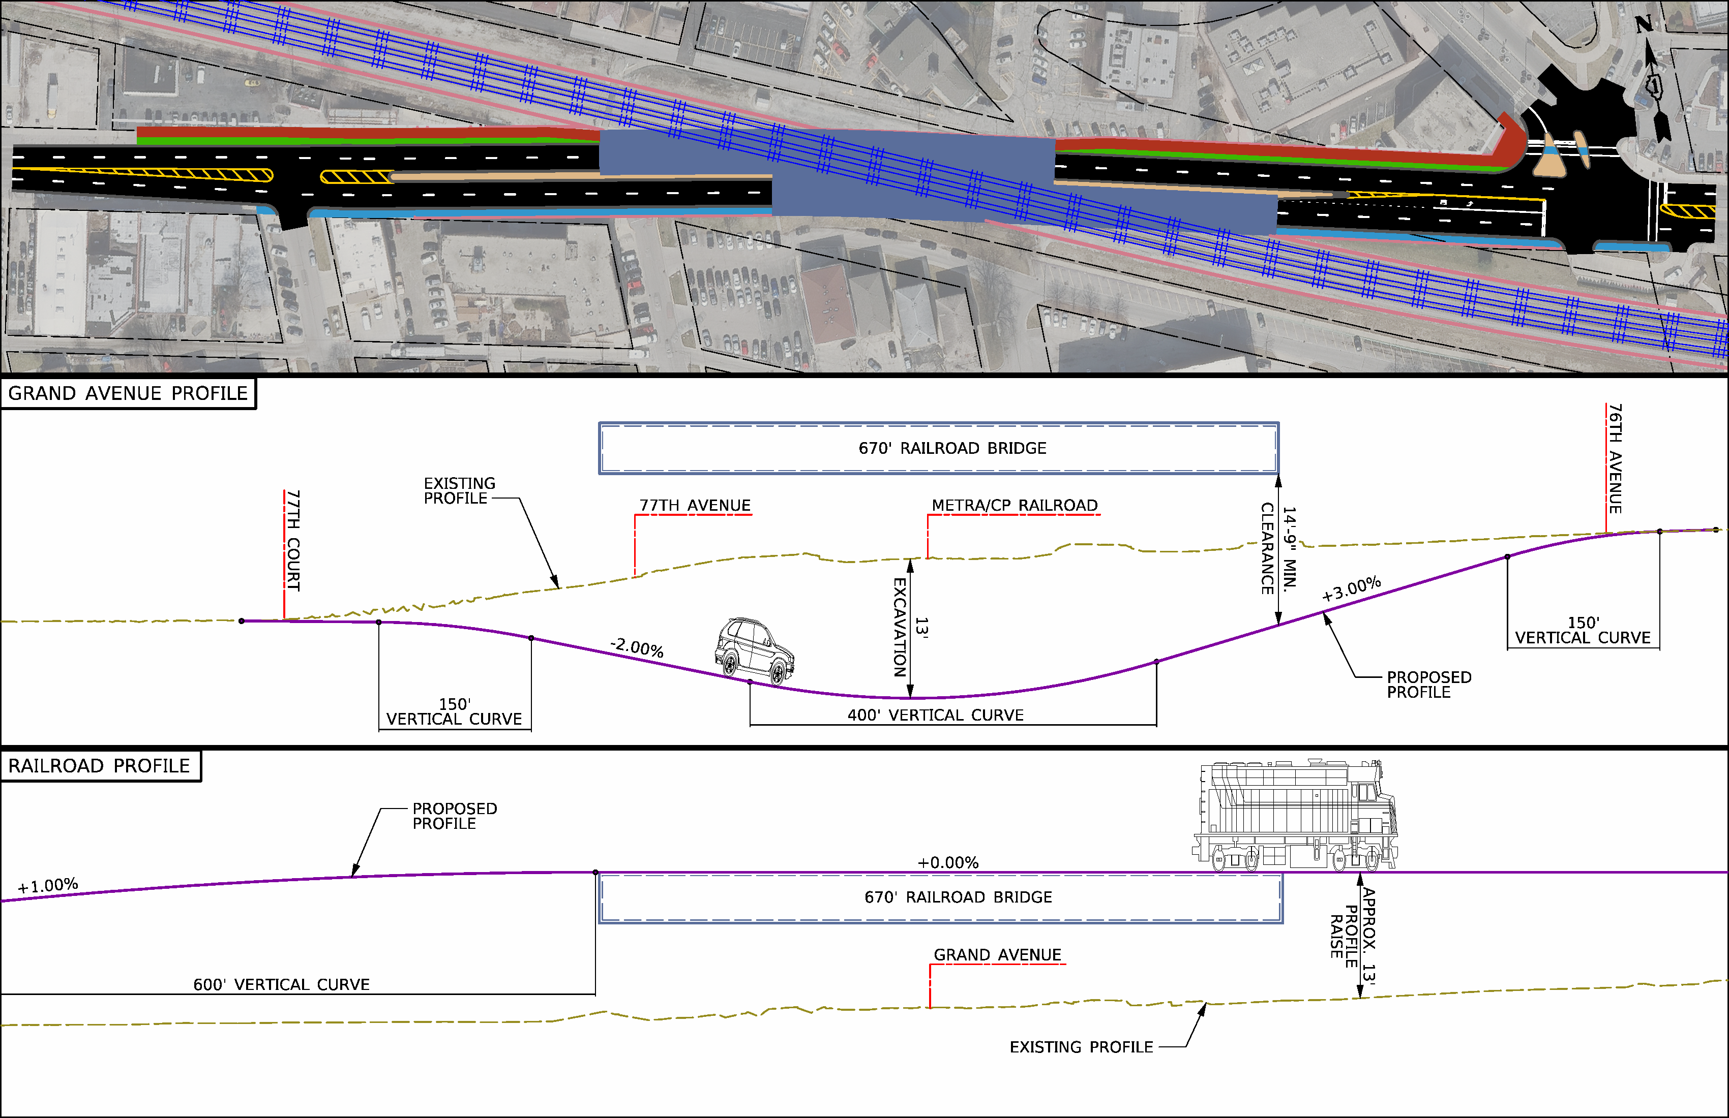
ALTERNATIVE #3 Combination of Lowering Grand Avenue & Raising Railroad
DESIGN:
Grand Avenue lowered 13 feet
Railroad raised 13 feet
76th Avenue profile maintained
Two single-span bridges
Metra station is reconstructed
Modifications to additional railroad crossings
Notes:
Alternative 3 lowers Grand Avenue approximately 13 feet and raises the railroad approximately 13 feet.
The existing 76th Avenue profile would be maintained.
Two staggered single-span bridges, with a pier in the median, would carry the railroad over Grand Avenue.
The Elmwood Park Metra station would be reconstructed in conjunction with the raising of the railroad profile. Canadian Pacific Railway and Metra operations and services would be maintained during construction.
Due to the raised railroad profile, the railroad crossings at 75th Avenue and 73rd Avenue would require modifications.

Slide 26
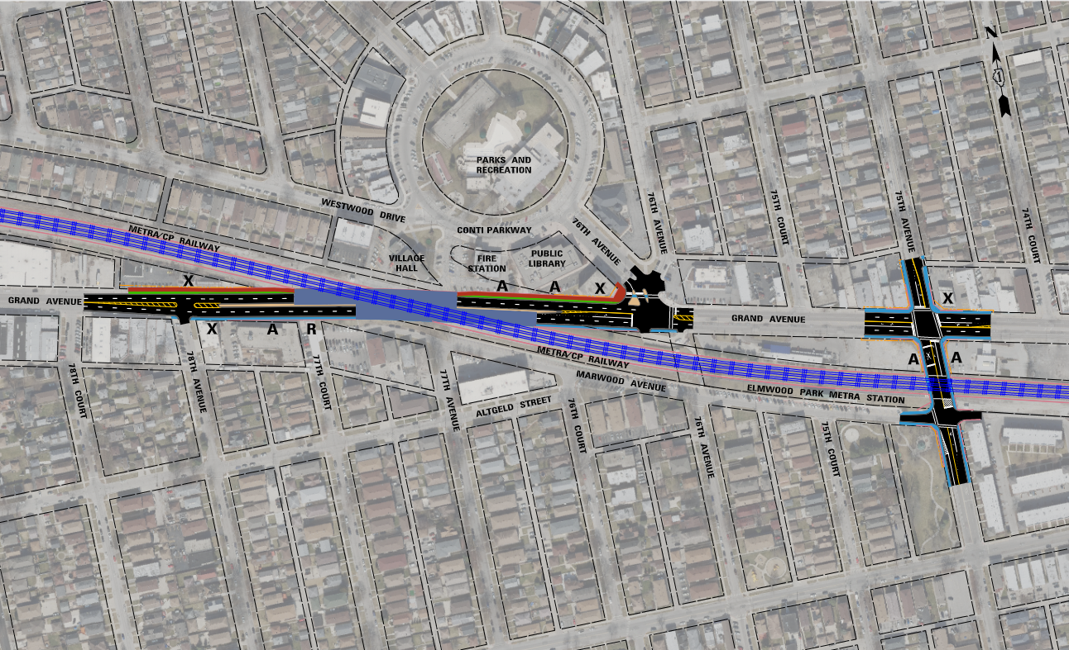
ALTERNATIVE #3 Combination of Lowering Grand Avenue & Raising Railroad
ISSUES:
Access to 77th Court removed
Access to Fire Station and Library removed
3 commercial displacements
1 residential displacement
21 parking spaces removed
Noise and Visual Impacts
Modification to 75th and 73rd Avenue
Notes:
Due to the profile adjustments in Alternative 3, access from Grand Avenue would be eliminated from 77th Court. The rear access to the Elmwood Park Fire Station and Public Library would also be eliminated. The Metra station pick-up and drop-off area would temporarily lose access to Grand Avenue during construction. That access would be restored upon completion of the project.
3 commercial properties and 1 residential property along Grand Avenue would be displaced.
Both on-street parking spaces and parking spaces behind the Elmwood Park Public Library and Fire Station would be impacted by the grade separation. A total of 21 spaces are estimated to be removed.
Noise and visual impacts are anticipated due to the raised railroad profile.
75th and 73rd Avenue will also require profile adjustments to accommodate the raised railroad profile. This will incur added cost and traffic delays during construction along with making the 75th Avenue railroad crossing more unsafe.

Slide 27
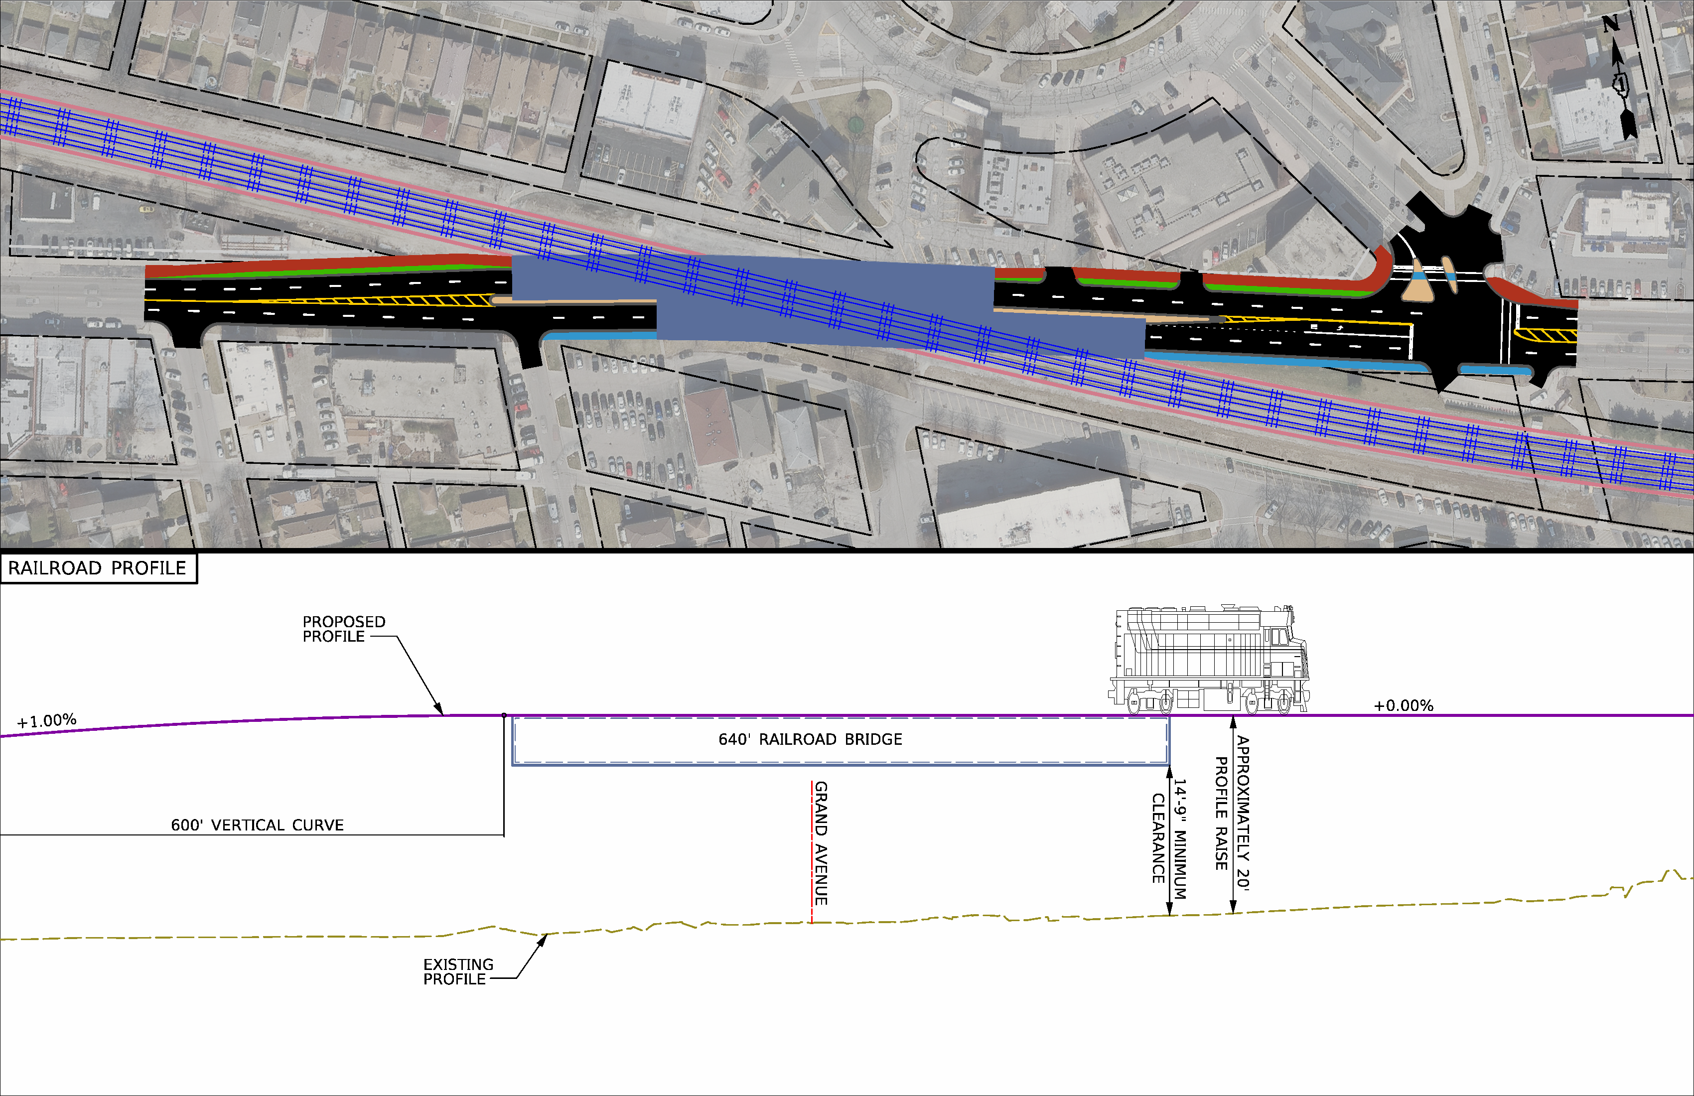
ALTERNATIVE #4 Railroad Over Grand Avenue
DESIGN:
Railroad raised 20 feet over existing Grand Avenue
76th Avenue profile maintained
Two single-span bridges
Metra station is reconstructed
Modifications to additional railroad crossings
Notes:
Alternative 4 would maintain the existing Grand Avenue profile and raise the railroad approximately 20 feet.
The existing 76th Avenue profile would be maintained.
Two staggered single-span bridges, with a pier in the median, would carry the railroad over Grand Avenue.
The Elmwood Park Metra station would be reconstructed in conjunction with the raising of the railroad profile. Canadian Pacific Railway and Metra operations and services would be maintained during construction.
Due to the raised railroad profile, the railroad crossings at 75th Avenue and 73rd Avenue would require modifications.

Slide 28
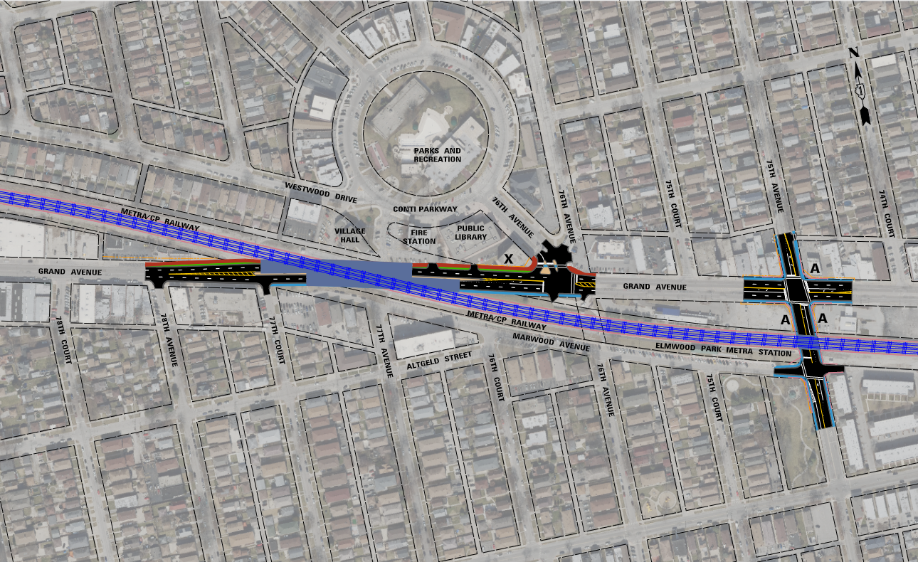
ALTERNATIVE #4 Railroad Over Grand Avenue
ISSUES:
Access to side roads is maintained
1 residential displacement
Additional Grade-Separation needed at 75th Avenue
Noise and Visual Impacts
Notes:
In Alternative 4, there is no roadway profile adjustment. All access points from Grand Avenue would be maintained.
1 residential property along Grand Avenue would be displaced.
Since the railroad profile is raised approximately 20 feet, another grade-separated railroad bridge must be introduced at the 75th Avenue railroad crossing. This would result in added costs, constructability issues, and traffic delays during construction.
The raised railroad would also bisect the community. This would create negative impacts to noise levels , visual aesthetics, and community cohesion.

Slide 29
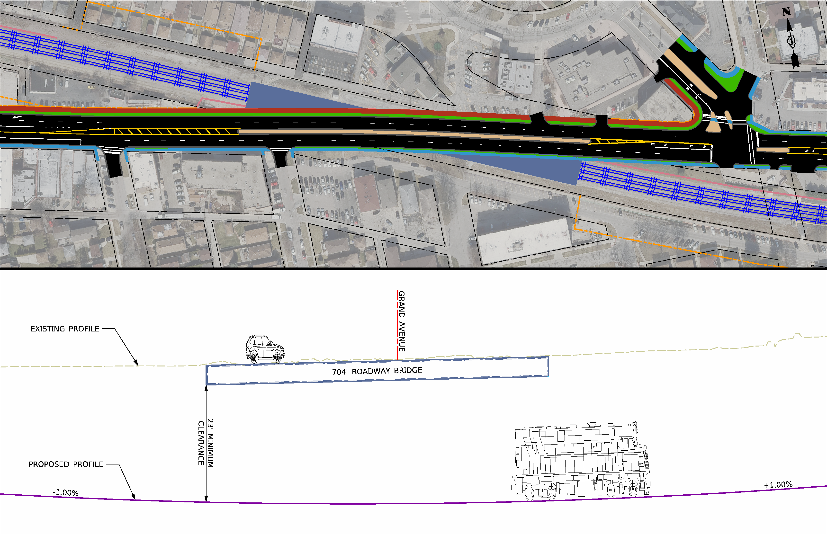
ALTERNATIVE #5 Railroad Under Grand Avenue
DESIGN:
Railroad lowered 30 feet under existing Grand Avenue
76th Avenue profile maintained
Concrete tunnel
Metra station is reconstructed
Modifications to additional railroad crossings
Notes:
Alternative 5 would maintain the existing Grand Avenue profile and lower the railroad approximately 30 feet.
The existing 76th Avenue profile would be maintained.
A three-sided concrete tunnel would be constructed to accommodate all three railroad tracks.
The Elmwood Park Metra station would be reconstructed in conjunction with the lowering of the railroad profile. Canadian Pacific Railway and Metra operations and services would be maintained during construction.
Due to the lowered railroad profile, the railroad crossings at 75th Avenue, 73rd Avenue, and Harlem Avenue would require modifications.

Slide 30
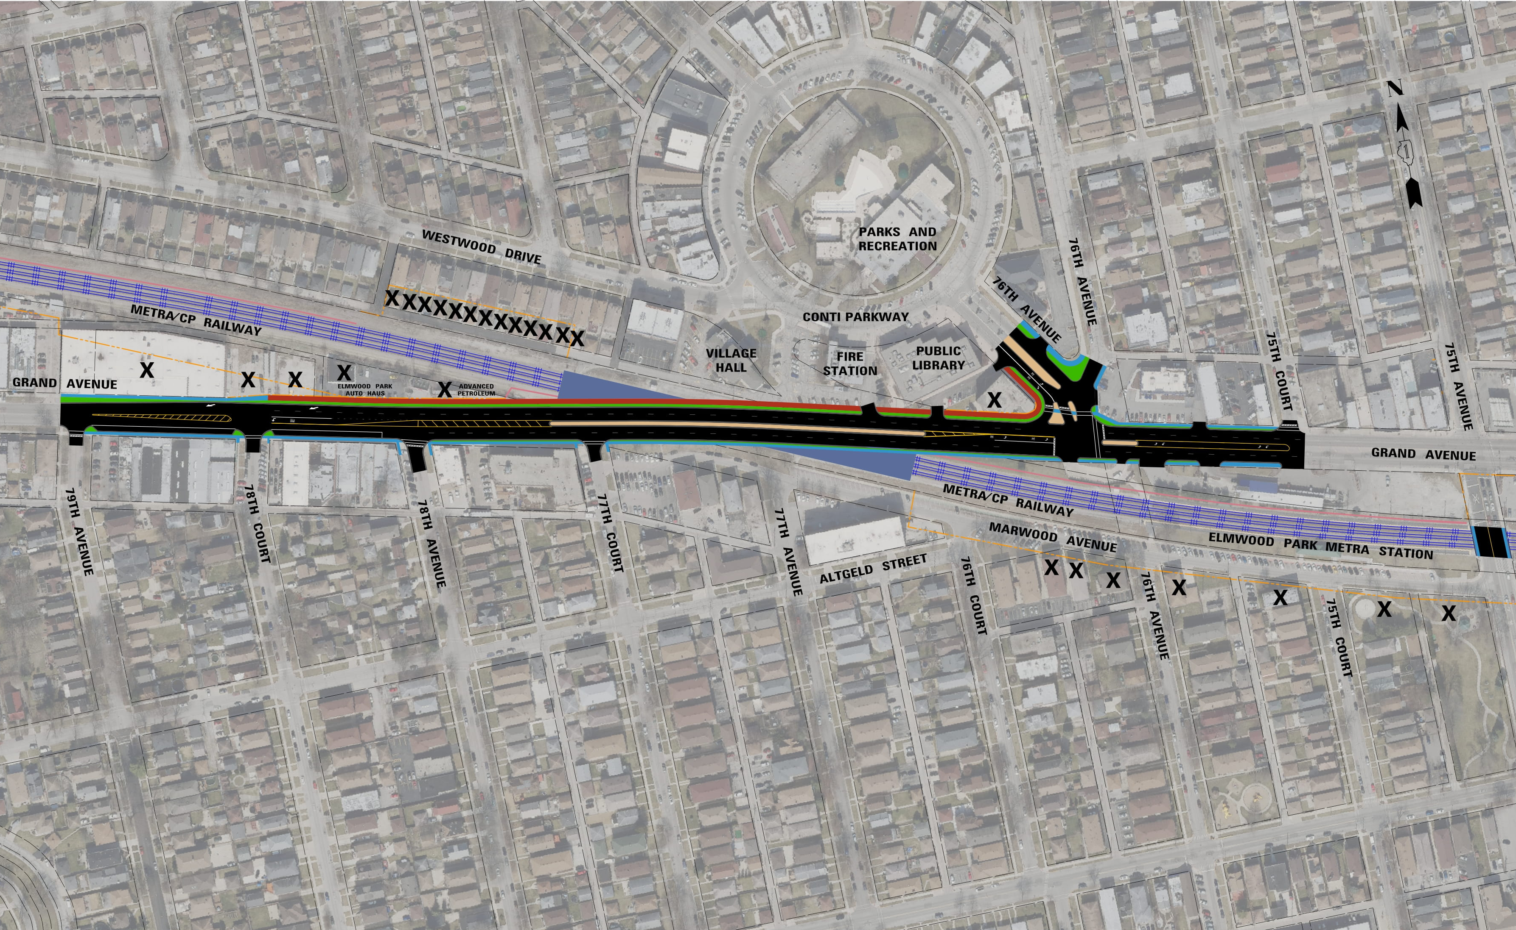
ALTERNATIVE #5 Railroad Under Grand Avenue
ISSUES:
Access to side roads is maintained
More than 5 commercial displacements
More than 21 residential displacements
25 parking spaces removed
Additional Grade-Separations needed at 75th, 73rd, and Harlem Avenue
Notes:
In Alternative 5, there is no roadway profile adjustment. All access points from Grand Avenue would be maintained.
At least 5 commercial properties and 21 residential properties along Grand Avenue would be displaced by this design due to extensive grading.
On-street parking spaces would be impacted by the grade separation. A total of 25 spaces are estimated to be removed.
The length of impacts for lowering the railroad profile extend beyond the scope of the project study area. 3 additional grade separations are needed to achieve this design. New roadway bridges must be constructed at 75th, 73rd, and even Harlem Avenue. This would add incur massive extra costs, traffic delays, and constructability issues.

Slide 31
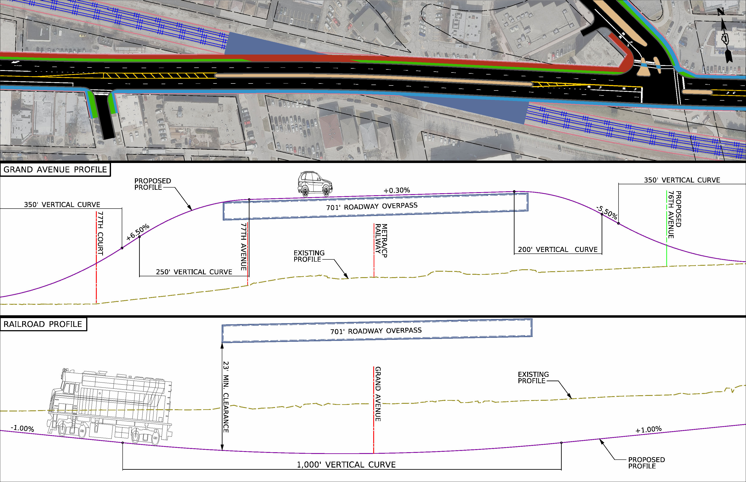
ALTERNATIVE #6 Combination of Lowering Railroad Under & Raising Grand Avenue
DESIGN:
Grand Avenue raised 19 feet
Railroad lowered 11 feet
76th Avenue raised 10 feet
Concrete tunnel
Metra station is reconstructed
Modifications to additional railroad crossings
Notes:
Alternative 6 would raise Grand Avenue approximately 19 feet and lower the railroad approximately 11 feet.
Consequently, 76th Avenue would be raised approximately 10 feet to meet the proposed Grand Avenue profile.
A three-sided concrete tunnel would be constructed to accommodate all three railroad tracks.
The Elmwood Park Metra station would be reconstructed in conjunction with the lowering of the railroad profile. Canadian Pacific Railway and Metra operations and services would be maintained during construction.
Due to the lowered railroad profile, the railroad crossings at 75th Avenue and 73rd Avenue would require modifications.

Slide 32
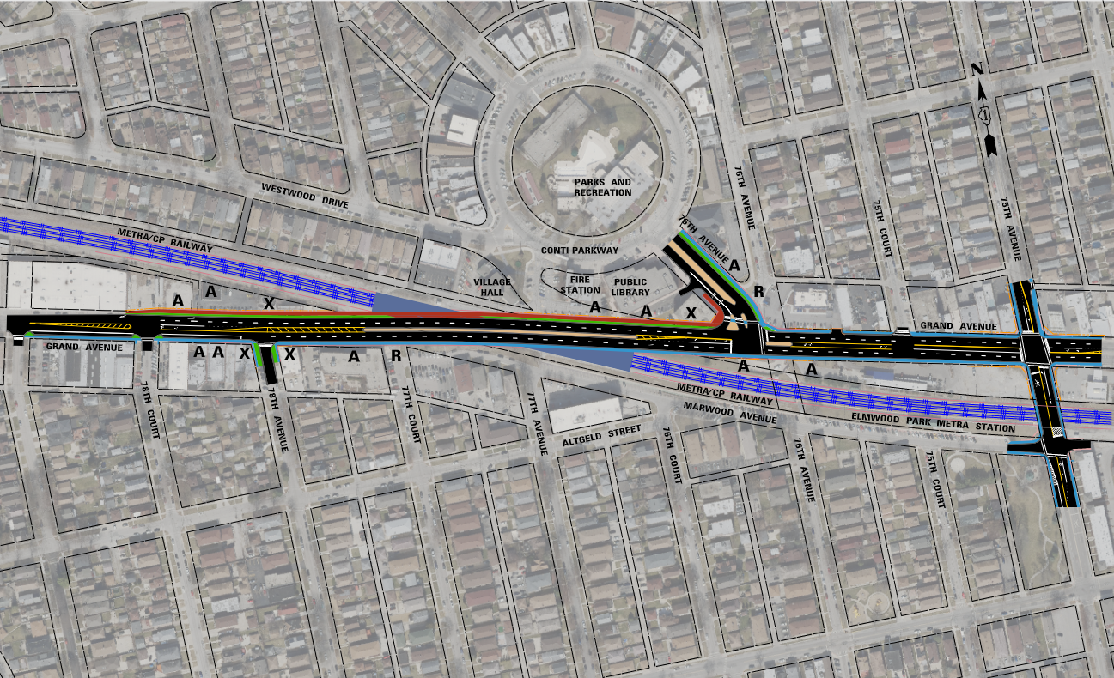
ALTERNATIVE #6 Combination of Lowering Railroad Under & Raising Grand Avenue
ISSUES:
Access to 77th Court removed
Access to Fire Station and Library removed
Access to 76th spur removed
Access to Metra pick-up/drop-off removed
3 commercial displacements
1 residential displacement
44 parking spaces are impacted
Notes:
Due to the profile adjustments in Alternative 6, access from Grand Avenue would be eliminated from 77th Court. The rear access to the Elmwood Park Fire Station and Public Library would also be eliminated. The spur off of 76th Avenue would also be removed. Existing Grand Avenue access for the Pace bus stop and Metra station pick-up and drop-off area would be eliminated.
3 commercial properties and 1 residential property along Grand Avenue would be displaced by this design.
Both on-street parking spaces and parking spaces behind the Elmwood Park Public Library and Fire Station would be impacted by the grade separation. A total of 44 spaces are estimated to be removed.

Slide 33
ALTERNATIVES COMPARISON
Alternatives | Cost | Displacements |  | Right of Way Acquisition | Side Road Impacts | Property Access Impacts
 |  | Residential | Commercial
Alternative 1 Grand Avenue Over Railroad | $109M | 2 | 10 | 10,700 SQ FT | 3 | 7
Alternative 2 Grand Avenue Under Railroad | $96M | 1 | 6 | 8,300 SQ FT | 2 | 4
Alternative 3 Hybrid Railroad Over and Grand Avenue Under | $124M | 1 | 3 | 10,500 SQ FT | 1 | 5
Alternative 4 Railroad Over Grand Avenue | $138M | 1 | 0 | 8,900 SQ FT | 0 | 3
Alternative 5 Railroad Under Grand Avenue | $583M | >21 | >5 | 649,300 SQ FT | 0 | 0
Alternative 6 Hybrid Grand Avenue Over and Railroad Under | $104M | 1 | 4 | 5,800 SQ FT | 2 | 10
Notes:
This table summarizes the construction cost and significant impacts associated with each of the six alternatives.
The cost of construction ranges from $96 million to $583 million.
Total displacements (both residential and commercial) range from 1 to more than 26.
The total area of right-of-way acquisition required ranges from approximately 8,000 square feet to 650,000 square feet.
Existing access impacts vary from zero to 12.

Slide 34
NEXT STEPS
Notes:
Here are the next steps for the project, going forward.

Slide 35
PHASE I STUDY TIMELINE
Comments for this public meeting will be accepted until June 7, 2022
Notes:
Following this meeting, the fourth Community Advisory Group meeting will be held to review the comments received from the public. These comments will help the team refine the alternatives and determine a preferred alternative. That alternative will be presented a Public Hearing in 2023. During the Public Hearing, residents can provide comments, on the record, regarding the alternative.
The team will then present the study and preferred alternative to IDOT for Design Approval. Once approval is received, the Village will work to advance the project into the next stage of design and will continue to work to secure funding assistance for construction.
If you would like to comment on the alternatives or other aspects of the public information meeting or project, please note that comments will be accepted for this public meeting
until June 7, 2022.

Slide 36
OPEN HOUSE DISCUSSION IN GYMNASIUM
Notes:
You are invited to review the exhibits in the gymnasium and ask questions. Project team members are located throughout the area and comment forms are available if you would like to leave written comments.

Slide 37
Your continued involvement and input is important to this project!
Thank you!
View project materials at www.grandgatewayep.com
Send us an email at: info@grandgatewayep.com
Mail a comment card to:
Grand Gateway Project
c/o Metro Strategies Group
1901 Butterfield Road, Suite 260
Downers Grove, IL 60515
Notes:
As a reminder we will be accepting comments until June 7, 2022. Comments can be submitted through the project website at www.grandgatewayep.com or via email at info@grandgatewayep.com.
Comments can also be mailed to 1901 Butterfield Road, Suite 260, Downers Grove, IL 60515
Thank you for your feedback, we appreciate your participation!

